Slide 1
Summary of measurable quantities

Slide 2
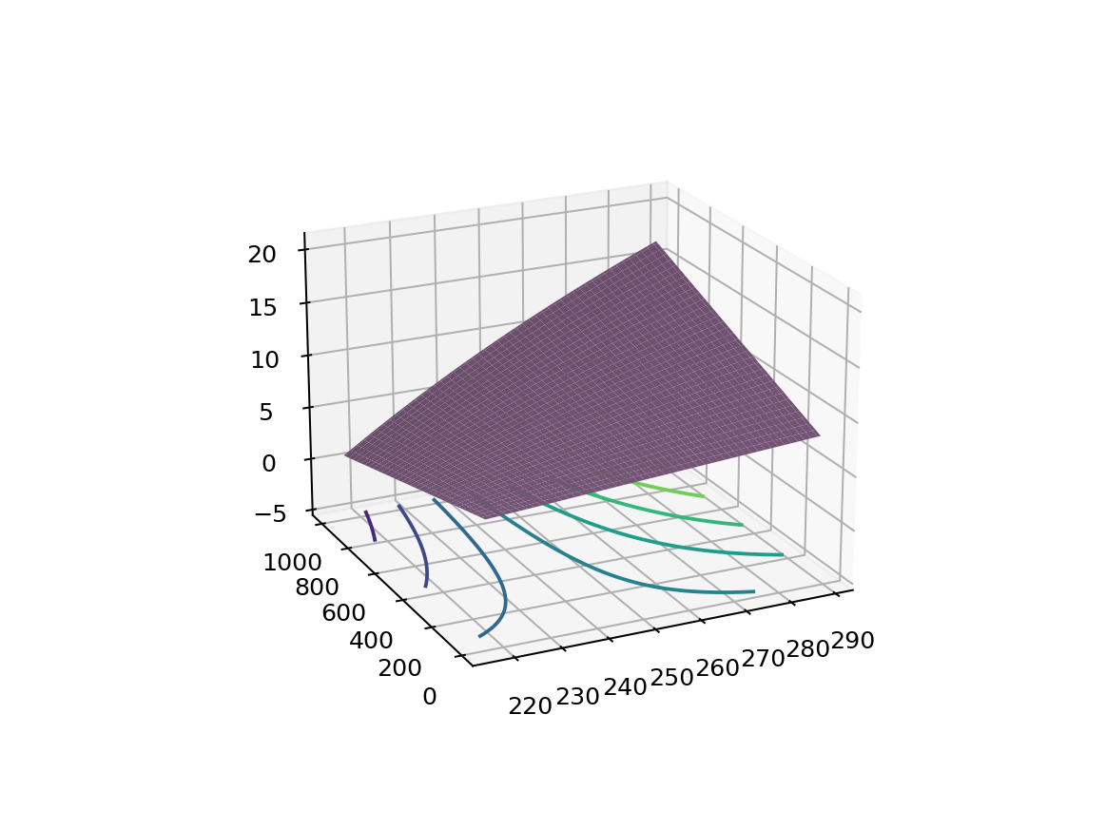
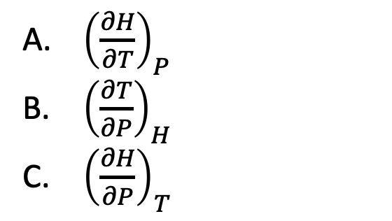
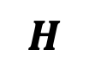
Across weeks – $H(T,P)$ as a thermodynamic surface (#1)
$$H$$
${\left(\frac{∂H}{∂T}\right)}_{P}$
${\left(\frac{∂T}{∂P}\right)}_{H}$
${\left(\frac{∂H}{∂P}\right)}_{T}$
P
T
Which is the correct description of the slopes of these lines?

Slide 3
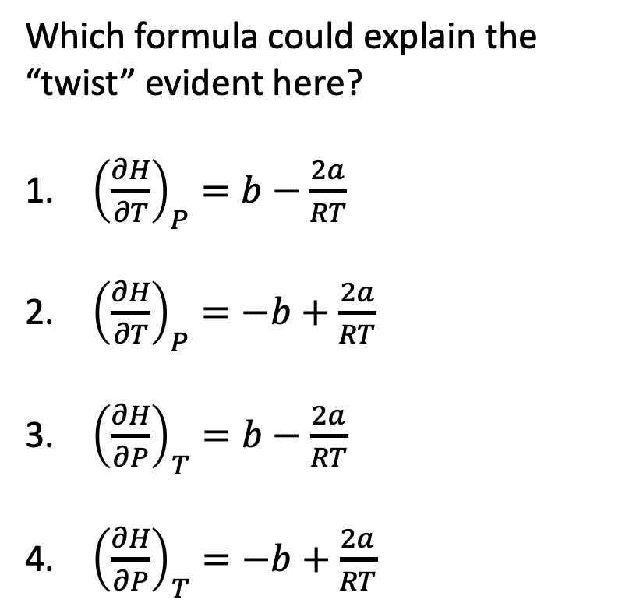
Across weeks – $H(T,P)$ as a thermodynamic surface (#2)
$$H$$
Which formula could explain the “twist” evident here?
${\left(\frac{∂H}{∂T}\right)}_{P}=b−\frac{2a}{RT}$
${\left(\frac{∂H}{∂T}\right)}_{P}=−b+\frac{2a}{RT}$
${\left(\frac{∂H}{∂P}\right)}_{T}=b−\frac{2a}{RT}$
${\left(\frac{∂H}{∂P}\right)}_{T}=−b+\frac{2a}{RT}$
P
T

Slide 4
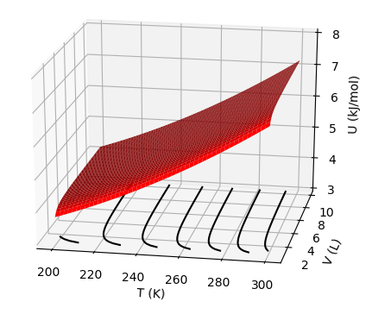

Across weeks – $U(T,V)$ as a thermodynamic surface (#1)
How is $π_{T}$ related to what we’re seeing here?

Slide 5
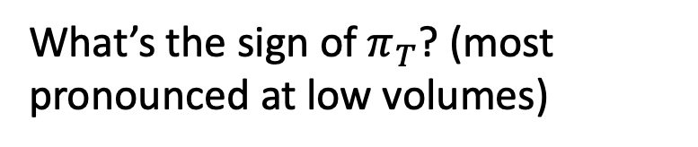
Across weeks – $U(T,V)$ as a thermodynamic surface (#2)
What’s the sign of $π_{T}$? (most pronounced at low volumes)

Slide 6
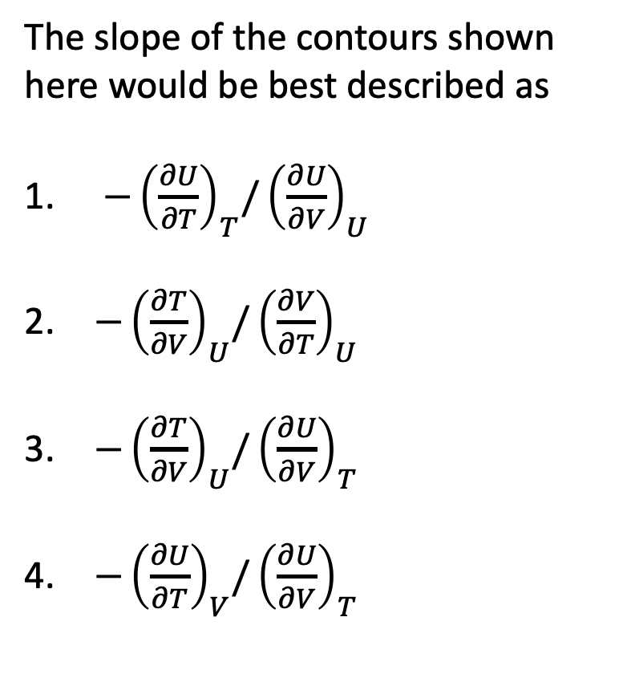
Across weeks – $U(T,V)$ as a thermodynamic surface (#3)
The slope of the contours shown here would be best described as
${−\left(\frac{∂U}{∂T}\right)}_{T}/{\left(\frac{∂U}{∂V}\right)}_{U}$
${−\left(\frac{∂T}{∂V}\right)}_{U}/{\left(\frac{∂V}{∂T}\right)}_{U}$
${−\left(\frac{∂T}{∂V}\right)}_{U}/{\left(\frac{∂U}{∂V}\right)}_{T}$
${−\left(\frac{∂U}{∂T}\right)}_{V}/{\left(\frac{∂U}{∂V}\right)}_{T}$

Slide 7
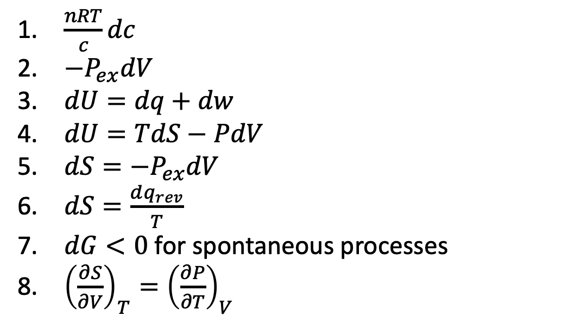
Across Weeks – Thermo matching (#1)
$\frac{nRT}{c}dc$
$−P_{ex}dV$
$dU=dq+dw$
$dU=TdS−PdV$
$dS=−P_{ex}dV$
$dS=\frac{dq_{rev}}{T}$
$dG<0$ for spontaneous processes
${\left(\frac{∂S}{∂V}\right)}_{T}={\left(\frac{∂P}{∂T}\right)}_{V}$
Matching:
1st Law
2nd Law
The Thermodynamic Definition of Entropy
A Maxwell relation
Non-PV work
PV work

Slide 8
Across Weeks – Thermo matching (#2)
$\frac{nRT}{c}dc$
$−P_{ex}dV$
$dU=dq+dw$
$dU=TdS−PdV$
$dS=−P_{ex}dV$
$dS=\frac{dq_{rev}}{T}$
$dG<0$ for spontaneous processes
${\left(\frac{∂S}{∂V}\right)}_{T}={\left(\frac{∂P}{∂T}\right)}_{V}$
Matching:
1st Law
2nd Law
The Thermodynamic Definition of Entropy
A Maxwell relation
Non-PV work
PV work

Slide 9
Across Weeks – Thermo matching (#3)
$\frac{nRT}{c}dc$
$−P_{ex}dV$
$dU=dq+dw$
$dU=TdS−PdV$
$dS=−P_{ex}dV$
$dS=\frac{dq_{rev}}{T}$
$dG<0$ for spontaneous processes
${\left(\frac{∂S}{∂V}\right)}_{T}={\left(\frac{∂P}{∂T}\right)}_{V}$
Matching:
1st Law
2nd Law
The Thermodynamic Definition of Entropy
A Maxwell relation
Non-PV work
PV work

Slide 10
Across Weeks – Thermo matching (#4)
$\frac{nRT}{c}dc$
$−P_{ex}dV$
$dU=dq+dw$
$dU=TdS−PdV$
$dS=−P_{ex}dV$
$dS=\frac{dq_{rev}}{T}$
$dG<0$ for spontaneous processes
${\left(\frac{∂S}{∂V}\right)}_{T}={\left(\frac{∂P}{∂T}\right)}_{V}$
Matching:
1st Law
2nd Law
The Thermodynamic Definition of Entropy
A Maxwell relation
Non-PV work
PV work

Slide 11
Across Weeks – Thermo matching (#5)
$\frac{nRT}{c}dc$
$−P_{ex}dV$
$dU=dq+dw$
$dU=TdS−PdV$
$dS=−P_{ex}dV$
$dS=\frac{dq_{rev}}{T}$
$dG<0$ for spontaneous processes
${\left(\frac{∂S}{∂V}\right)}_{T}={\left(\frac{∂P}{∂T}\right)}_{V}$
Matching:
1st Law
2nd Law
The Thermodynamic Definition of Entropy
A Maxwell relation
Non-PV work
PV work

Slide 12
Across Weeks – Thermo matching (#6)
$\frac{nRT}{c}dc$
$−P_{ex}dV$
$dU=dq+dw$
$dU=TdS−PdV$
$dS=−P_{ex}dV$
$dS=\frac{dq_{rev}}{T}$
$dG<0$ for spontaneous processes
${\left(\frac{∂S}{∂V}\right)}_{T}={\left(\frac{∂P}{∂T}\right)}_{V}$
Matching:
1st Law
2nd Law
The Thermodynamic Definition of Entropy
A Maxwell relation
Non-PV work
PV work

Slide 13
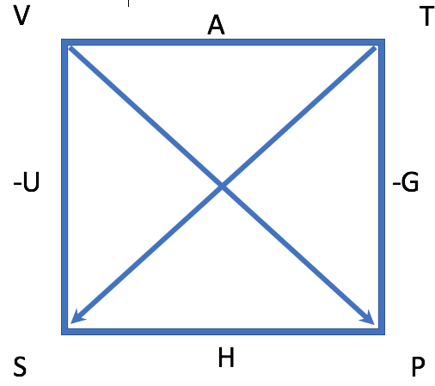
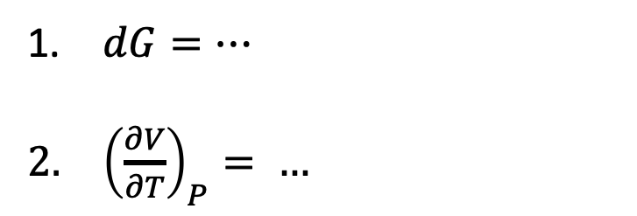
Across Weeks – The Box
According to the Box …
$dG=…$
${\left(\frac{∂V}{∂T}\right)}_{P}= …$

Slide 14


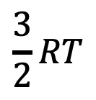

Weeks 4 & 14 – Heat capacities and vibrational motion (#1)
At the temperature indicated, which molecule has the highest heat capacity?
Energy
$$\frac{3}{2}RT$$
$$I_{2}$$
$$F_{2}$$
$$H_{2}$$

Slide 15
Weeks 4 & 14 – Heat capacities and vibrational motion (#2)
At the temperature indicated, which molecule(s) would you predict has/have an unscaled partition function ($Z′$) closest to 1?
Energy
$$\frac{3}{2}RT$$
$$I_{2}$$
$$F_{2}$$
$$H_{2}$$

Slide 16
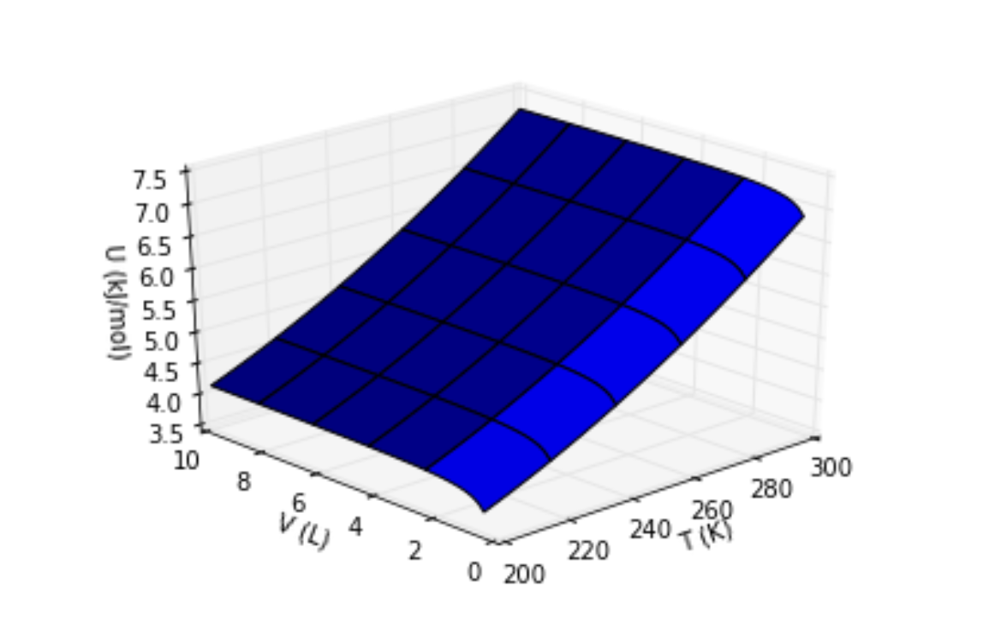
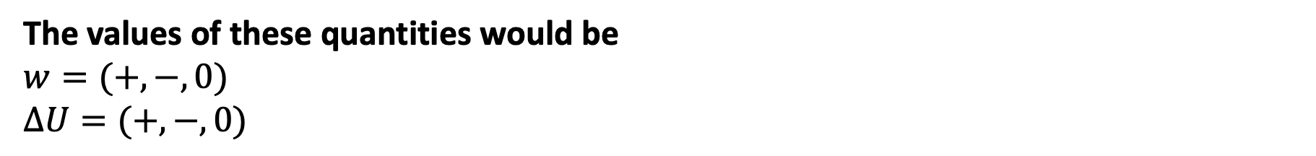
Week 6 - Applying the 1st law (#1)
A non-ideal gas expands isothermally and reversibly (from blue to green)
The values of these quantities would be
$$w=(+,−,0)$$
$∆U=(+,−,0)$

Slide 17
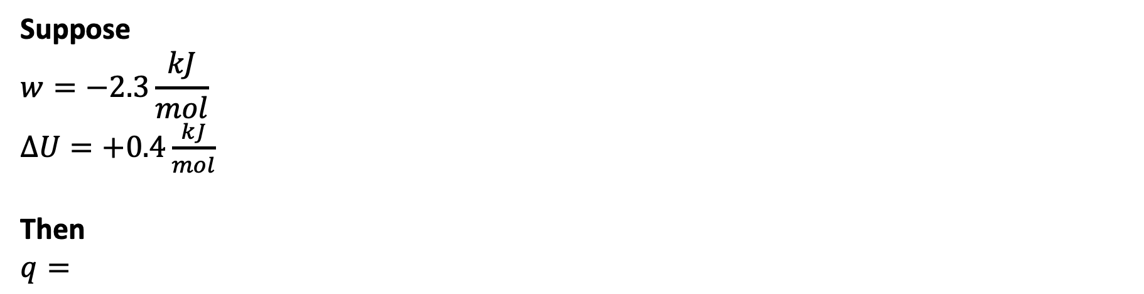
Week 6 - Applying the 1st law (#2)
A non-ideal gas expands isothermally and reversibly (from blue to green)
Suppose
$$w=−2.3\frac{kJ}{mol}$$
$∆U=+0.4\frac{kJ}{mol}$
Then
$q=$

Slide 18
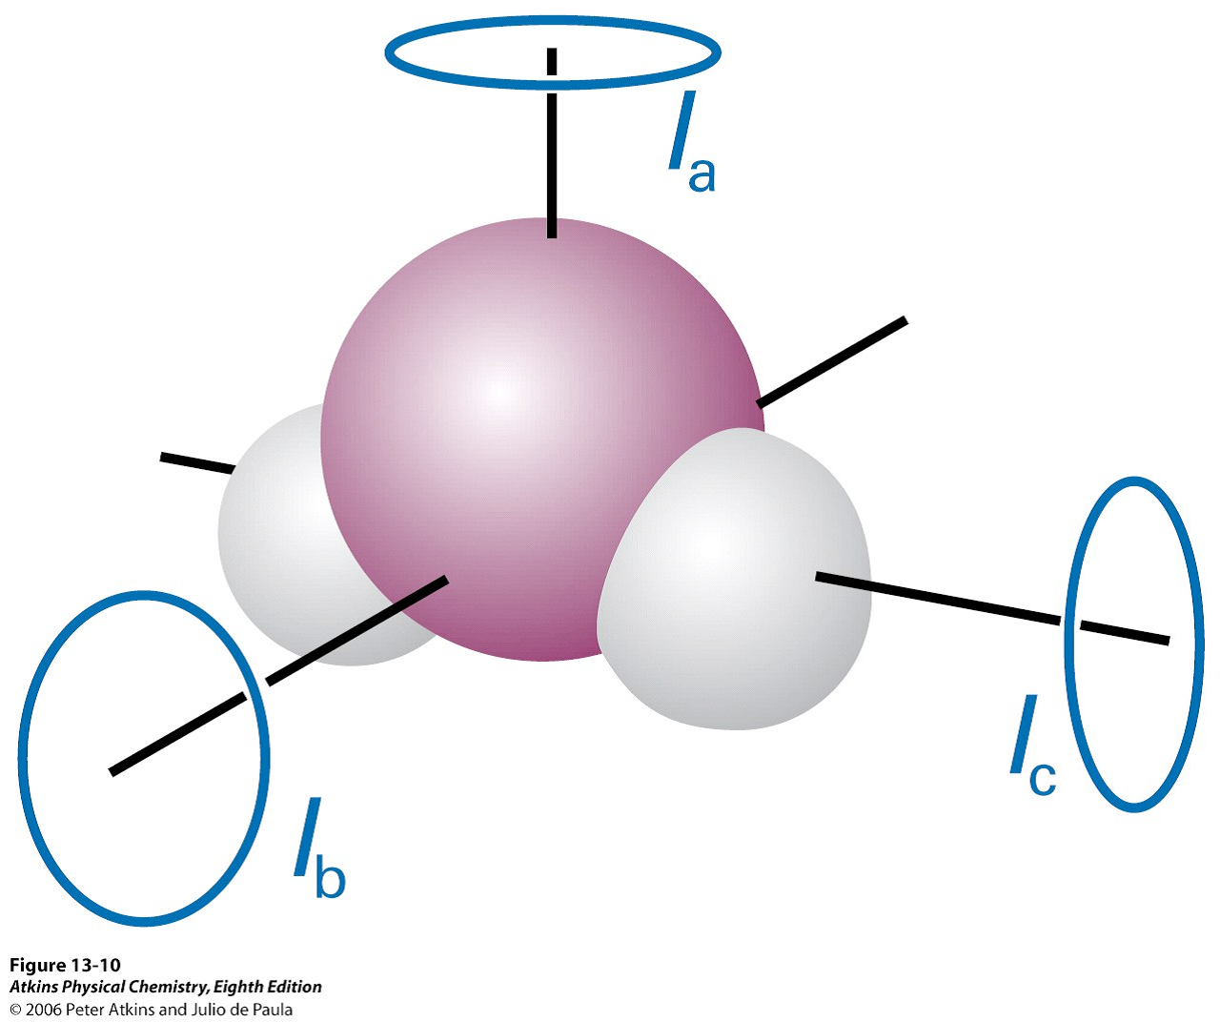
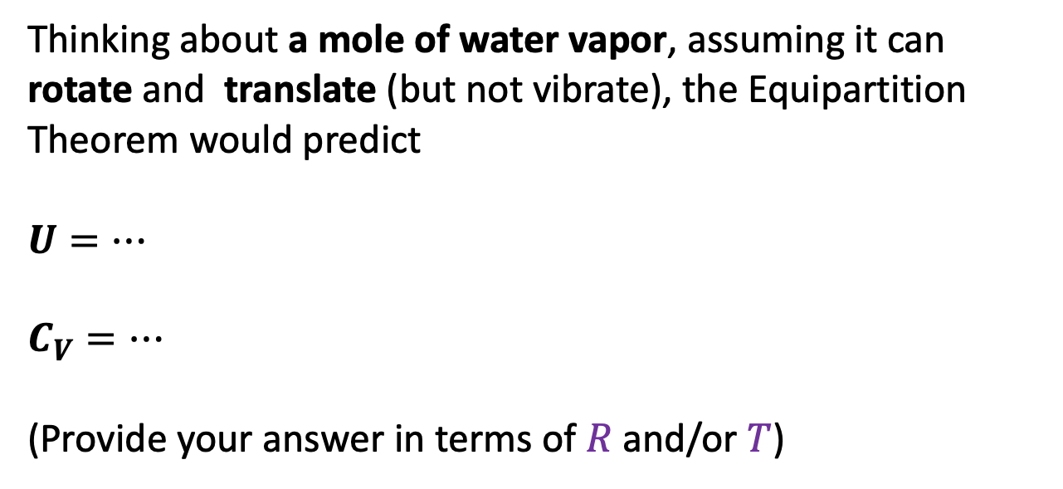
Week 6 - Heat capacities and energy
Thinking about a mole of water vapor, assuming it can rotate and translate (but not vibrate), the Equipartition Theorem would predict
$U=…$
$C_{V}=…$
(Provide your answer in terms of $R$ and/or $T$)

Slide 19
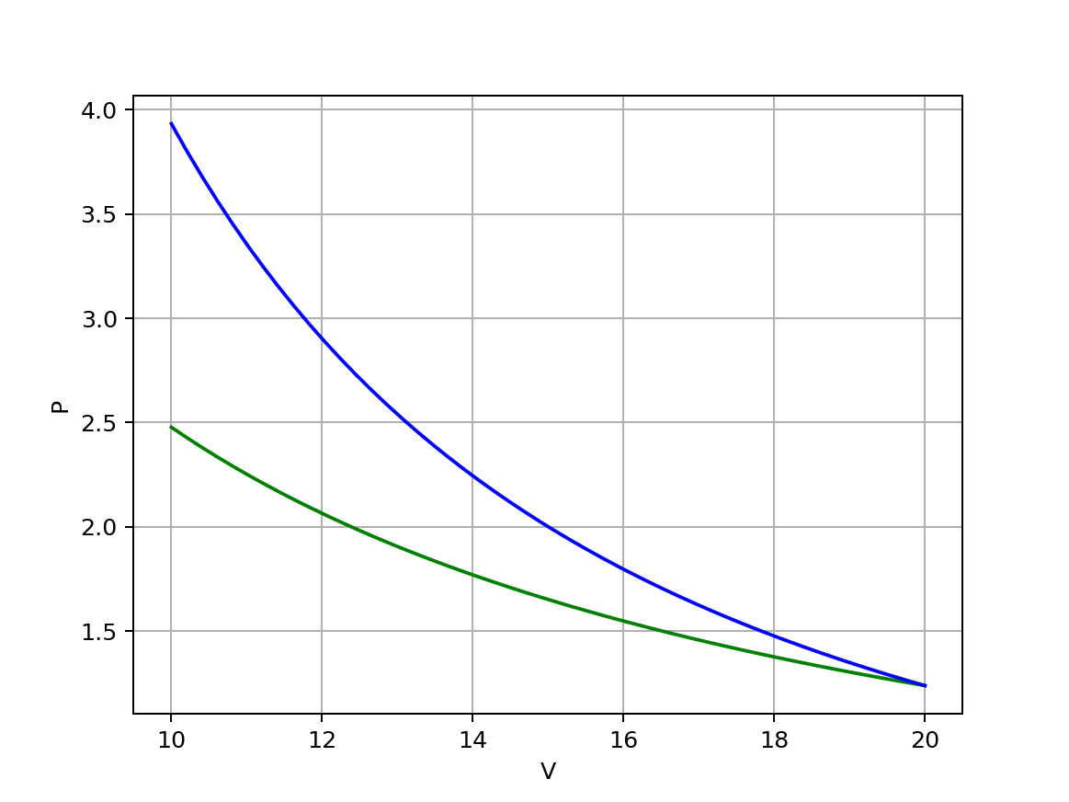
Week 6 – Compressing an ideal gas (#1)
Starting at the blue dot and compressing, one curve is isothermal, the other is adiabatic. Say which is which (and how you know).

Slide 20
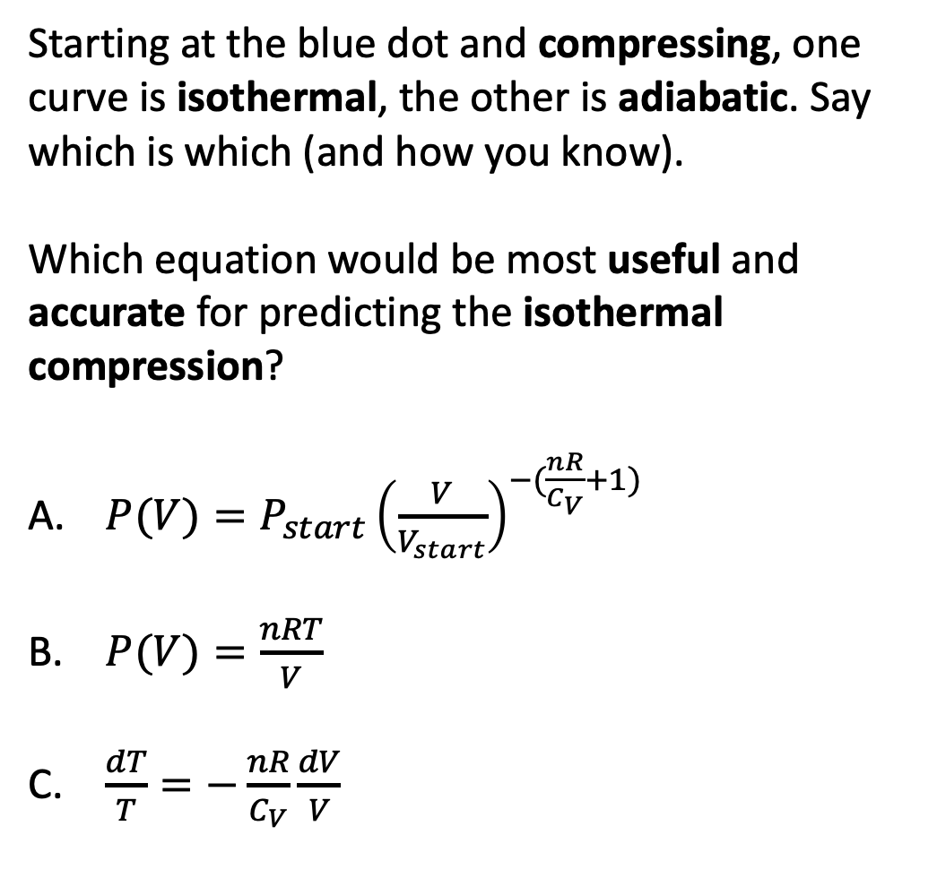
Week 6 – Compressing an ideal gas (#2)
Starting at the blue dot and compressing, one curve is isothermal, the other is adiabatic. Say which is which (and how you know).
Which equation would be most useful and accurate for predicting the isothermal compression?
$P(V)=P_{start}{\left(\frac{V}{V_{start}}\right)}^{−(\frac{nR}{C_{V}}+1)}$
$P(V)=\frac{nRT}{V}$
$\frac{dT}{T}=−\frac{nR}{C_{V}}\frac{dV}{V}$

Slide 21
Week 7 – Interpreting thermodynamic surfaces
$$H$$
Looks like 240 K is the
Critical temperature
Boyle temperature
Boiling temperature
Inversion temperature
H
P
T

Slide 22
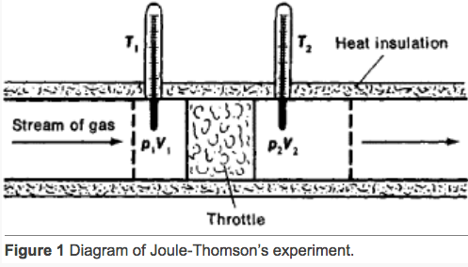
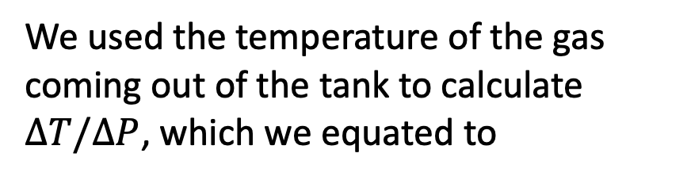
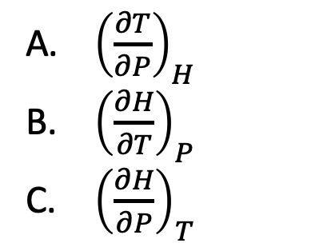
Week 7 – The adiabatic J-T experiment
$$H$$
H
We used the temperature of the gas coming out of the tank to calculate $∆T/∆P$, which we equated to
P
T
${\left(\frac{∂T}{∂P}\right)}_{H}$
${\left(\frac{∂H}{∂T}\right)}_{P}$
${\left(\frac{∂H}{∂P}\right)}_{T}$

Slide 23
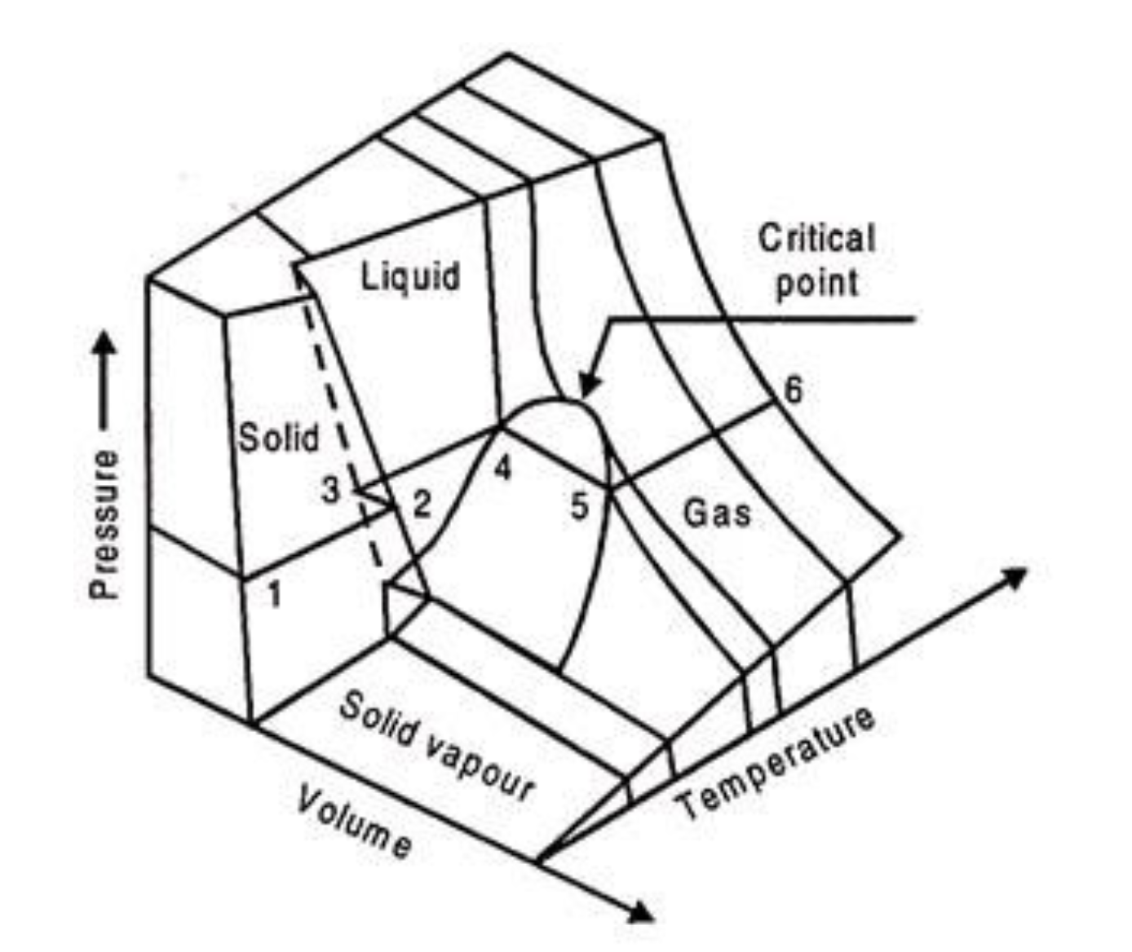
Week 7 – Corresponding states
The process at left corresponds to which curve?
Red
Blue
Orange
Green
gas
gas
liquid
liquid
Isothermal compression

Slide 24
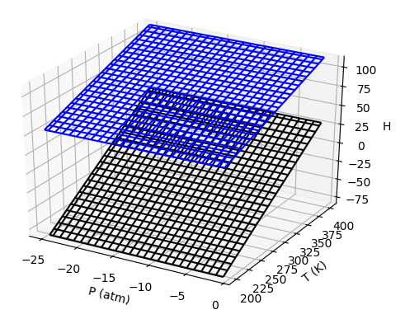
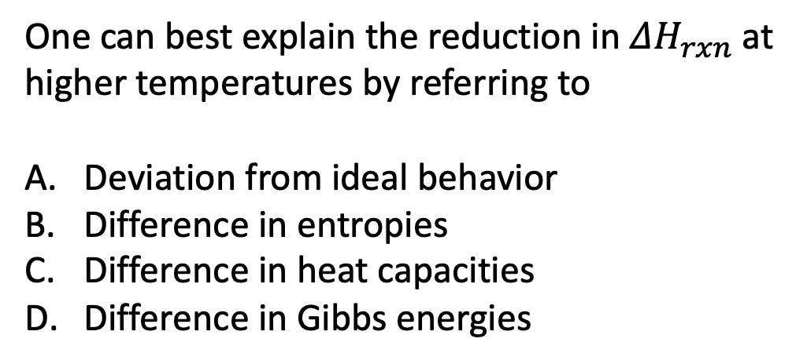
Week 8 - $ΔH_{rxn}$
Upper surface is vapor
One can best explain the reduction in $ΔH_{rxn}$ at higher temperatures by referring to
Deviation from ideal behavior
Difference in entropies
Difference in heat capacities
Difference in Gibbs energies
Lower surface is liquid

Slide 25

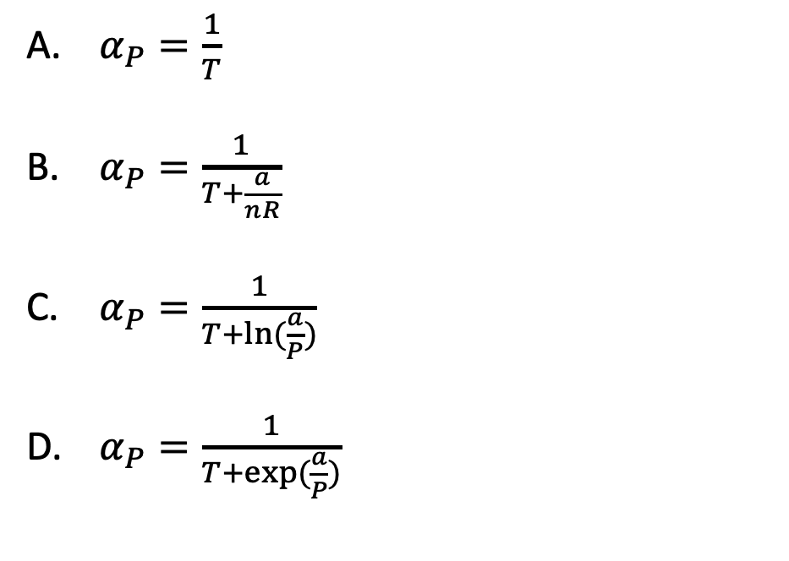
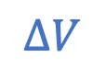

Week 9 – Expansivity and compressibility (#1)
$α_{P}≡\frac{1}{V}{\left(\frac{∂V}{∂T}\right)}_{P}$
Suppose we have a gas whose equation of state is $V=\frac{nRT}{P}+a/P$. Then
$α_{P}=\frac{1}{T}$
$α_{P}=\frac{1}{T+\frac{a}{nR}}$
$α_{P}=\frac{1}{T+ln⁡(\frac{a}{P})}$
$α_{P}=\frac{1}{T+exp⁡(\frac{a}{P})⁡}$
$$∆V$$
$$V$$

Slide 26

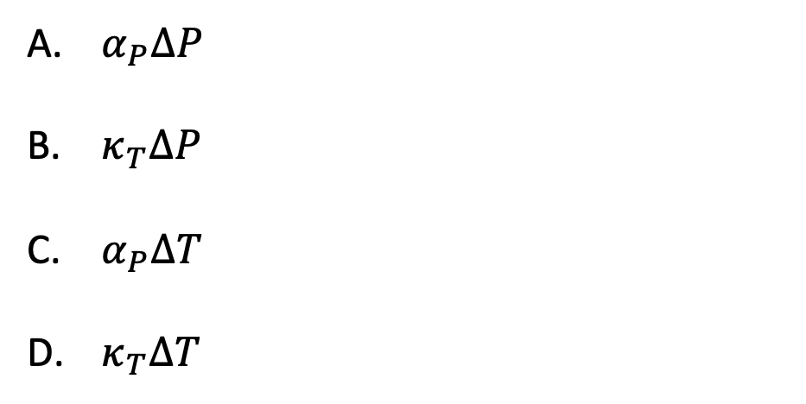
Week 9 – Expansivity and compressibility (#2)
$α_{P}≡\frac{1}{V}{\left(\frac{∂V}{∂T}\right)}_{P}$ , $κ_{T}≡−\frac{1}{V}{\left(\frac{∂V}{∂P}\right)}_{T}$
We said that for liquids and solids we can estimate the relative volume change associated with sea level rise due to climate change. Which is the relevant equation for $\frac{∆V}{V}$?
$$∆V$$
$α_{P}∆P$
$κ_{T}∆P$
$α_{P}∆T$
$κ_{T}∆T$
$$V$$

Slide 27
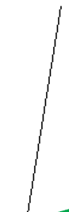
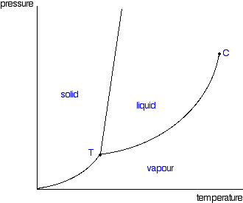
Week 9 – Phase diagrams
P
Clapeyron
Clausius-Clapeyron
Raoult
Thomson
…
…
…
A (line)
B (line)
T
C (slopes)

Slide 28
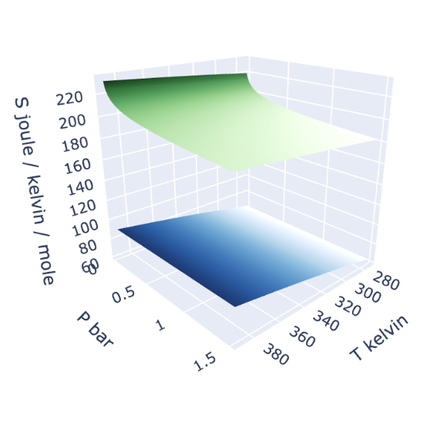
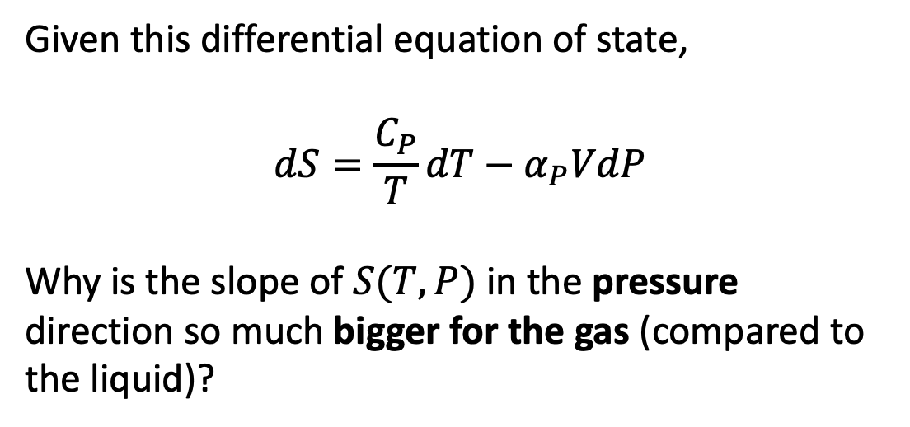
Weeks 10 & 11 – Entropy and the 2nd Law (#1)
Given this differential equation of state,
$$dS=\frac{C_{P}}{T}dT−α_{P}VdP$$
Why is the slope of $S(T,P)$ in the pressure direction so much bigger for the gas (compared to the liquid)?
gas
liquid

Slide 29
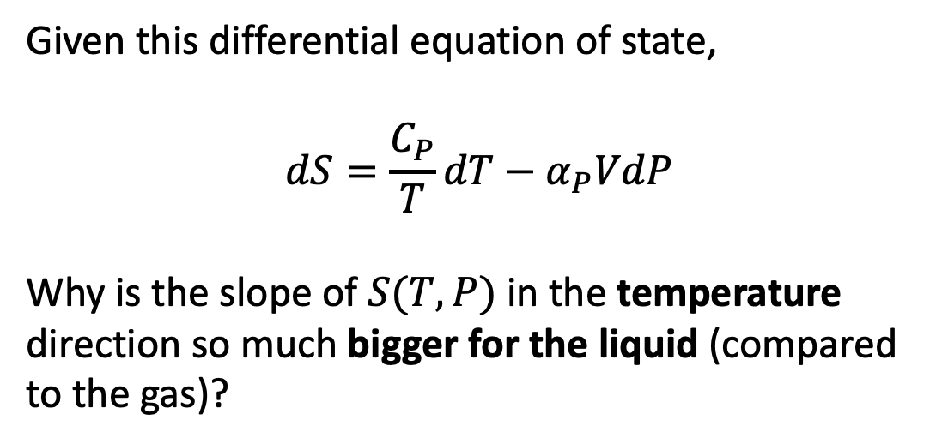
Weeks 10 & 11 – Entropy and the 2nd Law (#2)
Given this differential equation of state,
$$dS=\frac{C_{P}}{T}dT−α_{P}VdP$$
Why is the slope of $S(T,P)$ in the temperature direction so much bigger for the liquid (compared to the gas)?
gas
liquid

Slide 30
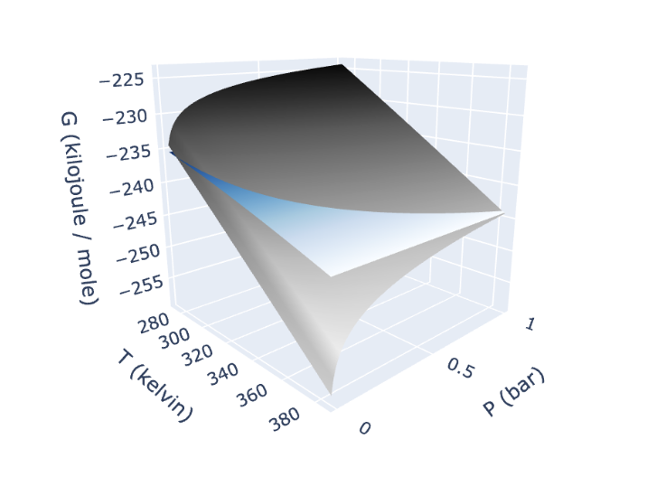
Week 12 – $G(T,P)$ thermodynamic surface (#1)
Compared to the liquid surface, how do we know that the gas’s Gibbs energy surface must be steeper in the pressure direction than that of the liquid?
Liquid
Gas

Slide 31
Week 12 – $G(T,P)$ thermodynamic surface (#2)
Compared to the liquid surface, how do we know that the gas’s Gibbs energy surface must be steeper in the temperature direction?
Liquid
Gas

Slide 32
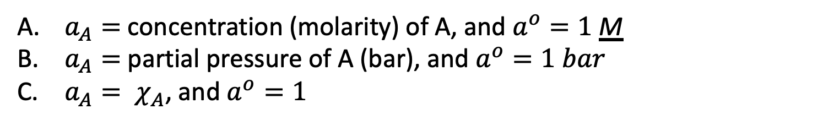

Week 12 – Chemical potentials (#1)
$$μ_{A}=μ_{A}^{o}+RT ln\frac{a_{A}}{a^{o}}$$
If A is a solute, then
$a_{A}=$ concentration (molarity) of A, and $a^{o}=1$ M
$a_{A}=$ partial pressure of A (bar), and $a^{o}=1 bar$
$a_{A}= χ_{A}$, and $a^{o}=1$

Slide 33
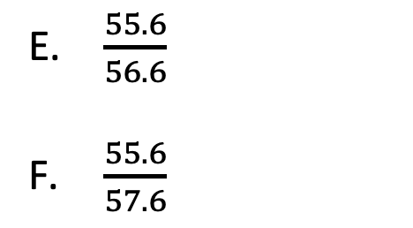
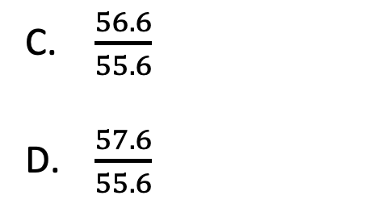
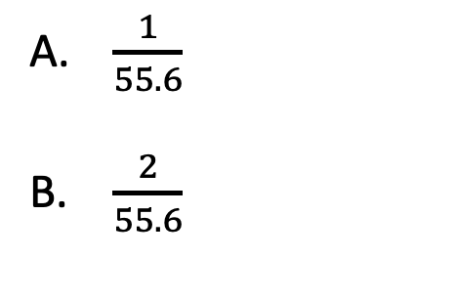
Week 12 – Chemical potentials (#2)
$$μ_{A}=μ_{A}^{o}+RT ln\frac{a_{A}}{a^{o}}$$
Suppose A is a solvent (water) and the solute is 1 M $NaCl(aq)$. Then the correct expression for $a_{A}$is
$\frac{1}{55.6}$
$\frac{2}{55.6}$
$\frac{56.6}{55.6}$
$\frac{57.6}{55.6}$
$\frac{55.6}{56.6}$
$\frac{55.6}{57.6}$

Slide 34

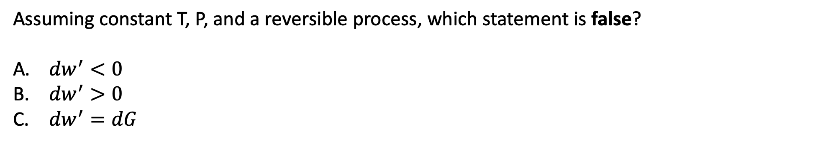
Week 13 – non-PV work
State “X”
$${dw}^{′}$$
The System
State “Y”
Assuming constant T, P, and a reversible process, which statement is false?
${dw}^{′}<0$
${dw}^{′}>0$
${dw}^{′}=dG$

Slide 35
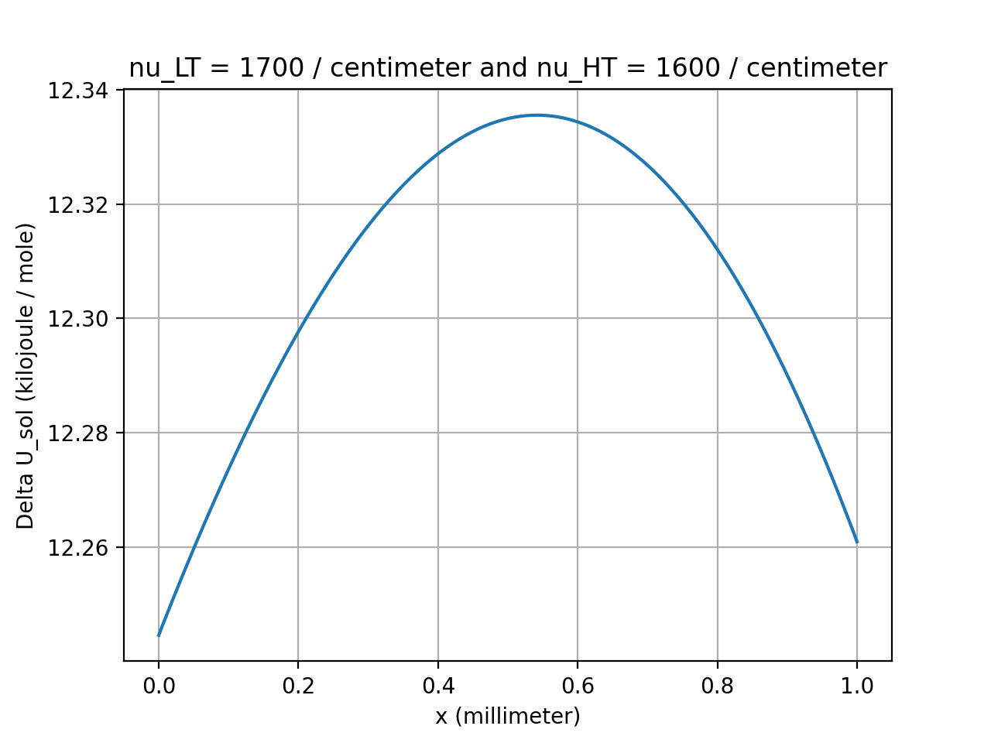
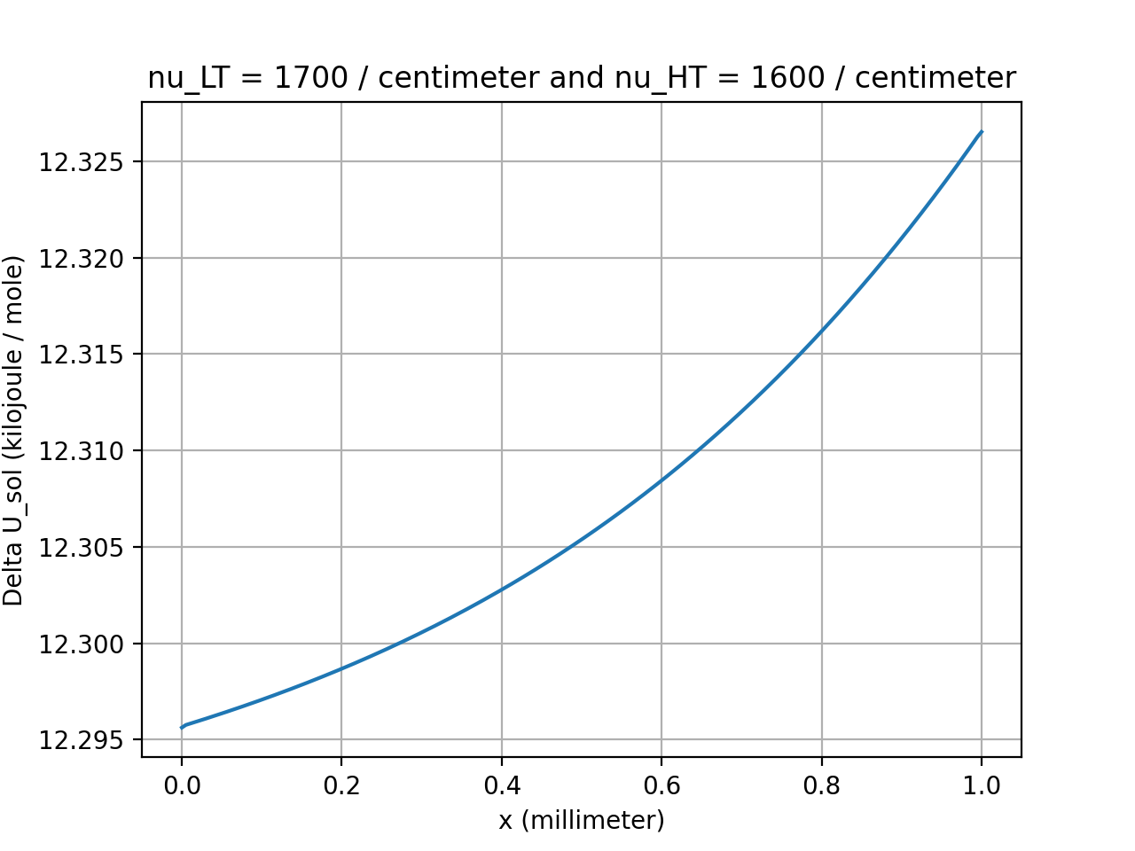
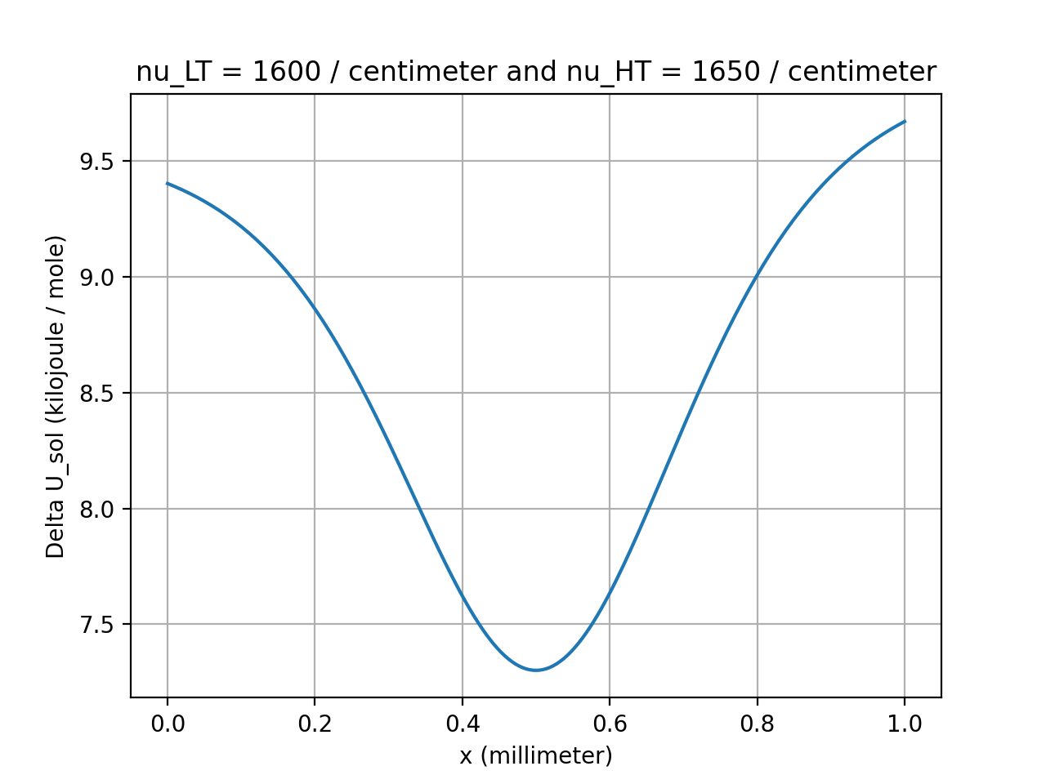




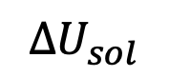
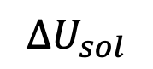
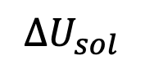
Week 14 – Matching thermophoresis to ${∆U}_{sol}$
$${∆U}_{sol}$$
$${∆U}_{sol}$$
$${∆U}_{sol}$$
A, B, C, D
A, B, C, D
A, B, C, D
A
C
B
D

Slide 36
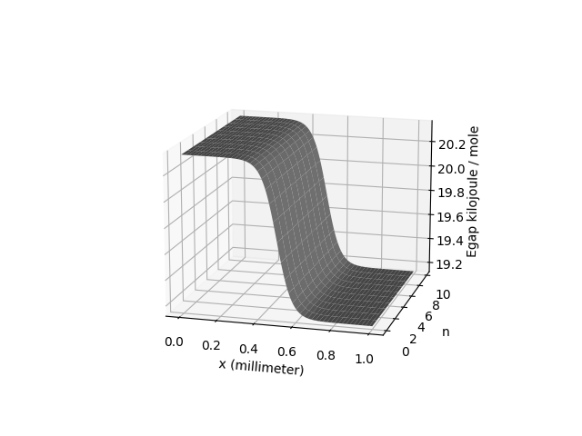
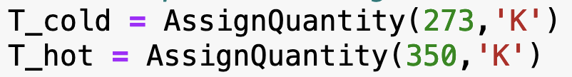
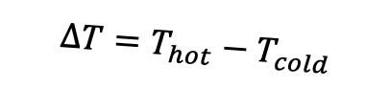
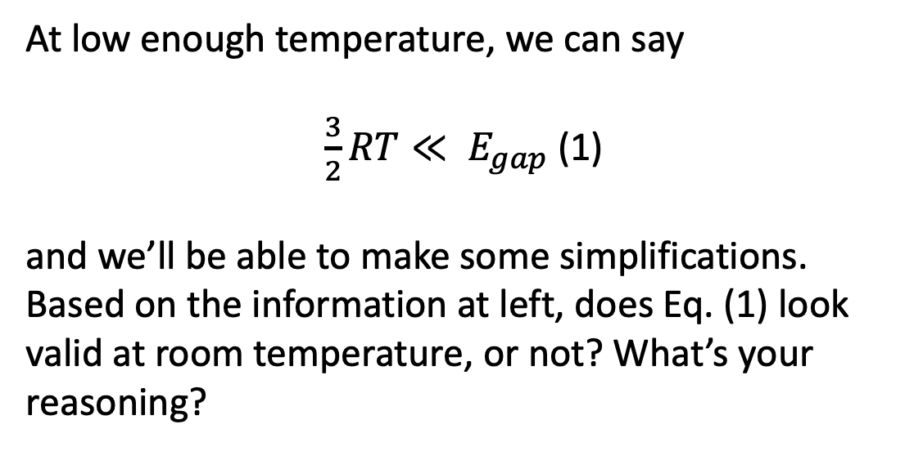
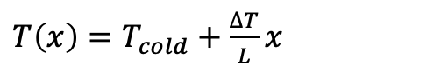

Week 14 – $E_{gap}$ and temperature
$$E_{gap}$$
At low enough temperature, we can say
$\frac{3}{2}RT≪ E_{gap}$ (1)
and we’ll be able to make some simplifications. Based on the information at left, does Eq. (1) look valid at room temperature, or not? What’s your reasoning?
$$∆T=T_{hot}−T_{cold}$$
$T\left(x\right)=T_{cold}+\frac{∆T}{L}x$

Slide 37
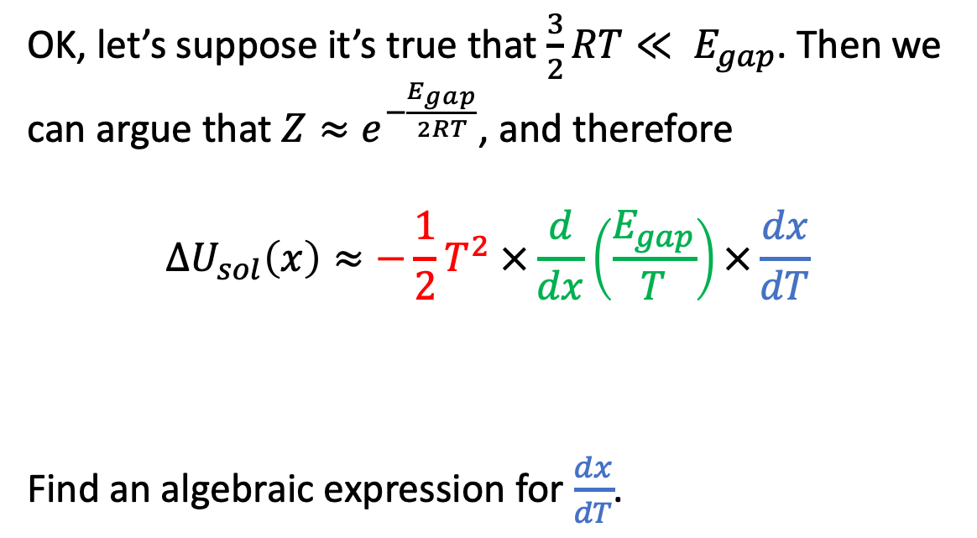
Week 14 – Derivation of $U_{sol}$ (#1)
OK, let’s suppose it’s true that $\frac{3}{2}RT≪ E_{gap}$. Then we can argue that ${Z≈e}^{−\frac{E_{gap}}{2RT}}$, and therefore
$${∆U}_{sol}\left(x\right)≈−\frac{1}{2}T^{2} ×\frac{d}{dx}\left(\frac{E_{gap}}{T}\right)×\frac{dx}{dT}$$
Find an algebraic expression for $\frac{dx}{dT}$.
$$E_{gap}$$
$$∆T=T_{hot}−T_{cold}$$
$T\left(x\right)=T_{cold}+\frac{∆T}{L}x$

Slide 38


Week 14 – Derivation of $U_{sol}$ (#2)
OK, let’s suppose it’s true that $\frac{3}{2}RT≪ E_{gap}$. Then we can argue that ${Z≈e}^{−\frac{E_{gap}}{2RT}}$, and therefore
$$∆U_{sol}\left(x\right)≈RT^{2} ×\frac{d}{dx}\ln\left(\exp\left(−\frac{E_{gap}}{2RT}\right)\right) ×\frac{dx}{dT}$$
A logical next step in simplifying the green term would be …
$$E_{gap}$$
$$∆T=T_{hot}−T_{cold}$$
$$T\left(x\right)=T_{cold}+\frac{∆T}{L}x$$

Slide 39

Week 14 – Derivation of $U_{sol}$ (#3)
OK, let’s suppose it’s true that $\frac{3}{2}RT≪ E_{gap}$. Then we can argue that ${Z≈e}^{−\frac{E_{gap}}{2RT}}$, and therefore
$$U_{sol}\left(x\right)≈−\frac{1}{2}T^{2} ×\frac{d}{dx}\left(\frac{E_{gap}}{T}\right)×\frac{dx}{dT}$$
A logical next step in simplifying the green term would be to apply the product rule, which would give
$\frac{d}{dx}\left(\frac{E_{gap}}{T}\right)=\frac{dE_{gap}}{dx}× A+\frac{d\left(\frac{1}{T}\right)}{dx}× B$
where $A=______$ and $B=______$
$$E_{gap}$$
$$∆T=T_{hot}−T_{cold}$$
$$T\left(x\right)=T_{cold}+\frac{∆T}{L}x$$

